Slide 1

Insights from Web Scraping

Slide 2
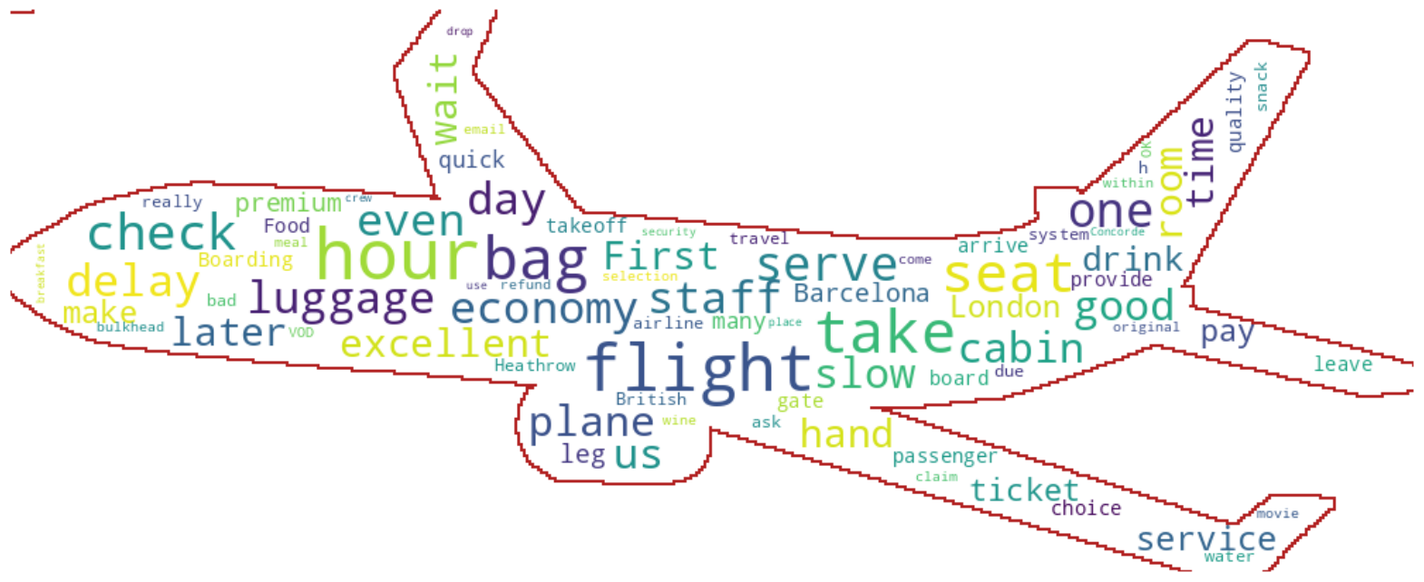
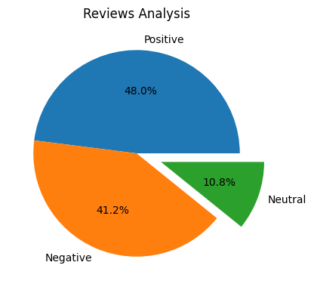
I obtained out of 1000 reviews given by customers.
480 Positive
412 Negative
108 Neutral
The most commonly Positive word used in reviews was Flight.
The most commonly Negative word used in reviews was Seats and Hours.

